Slide 1
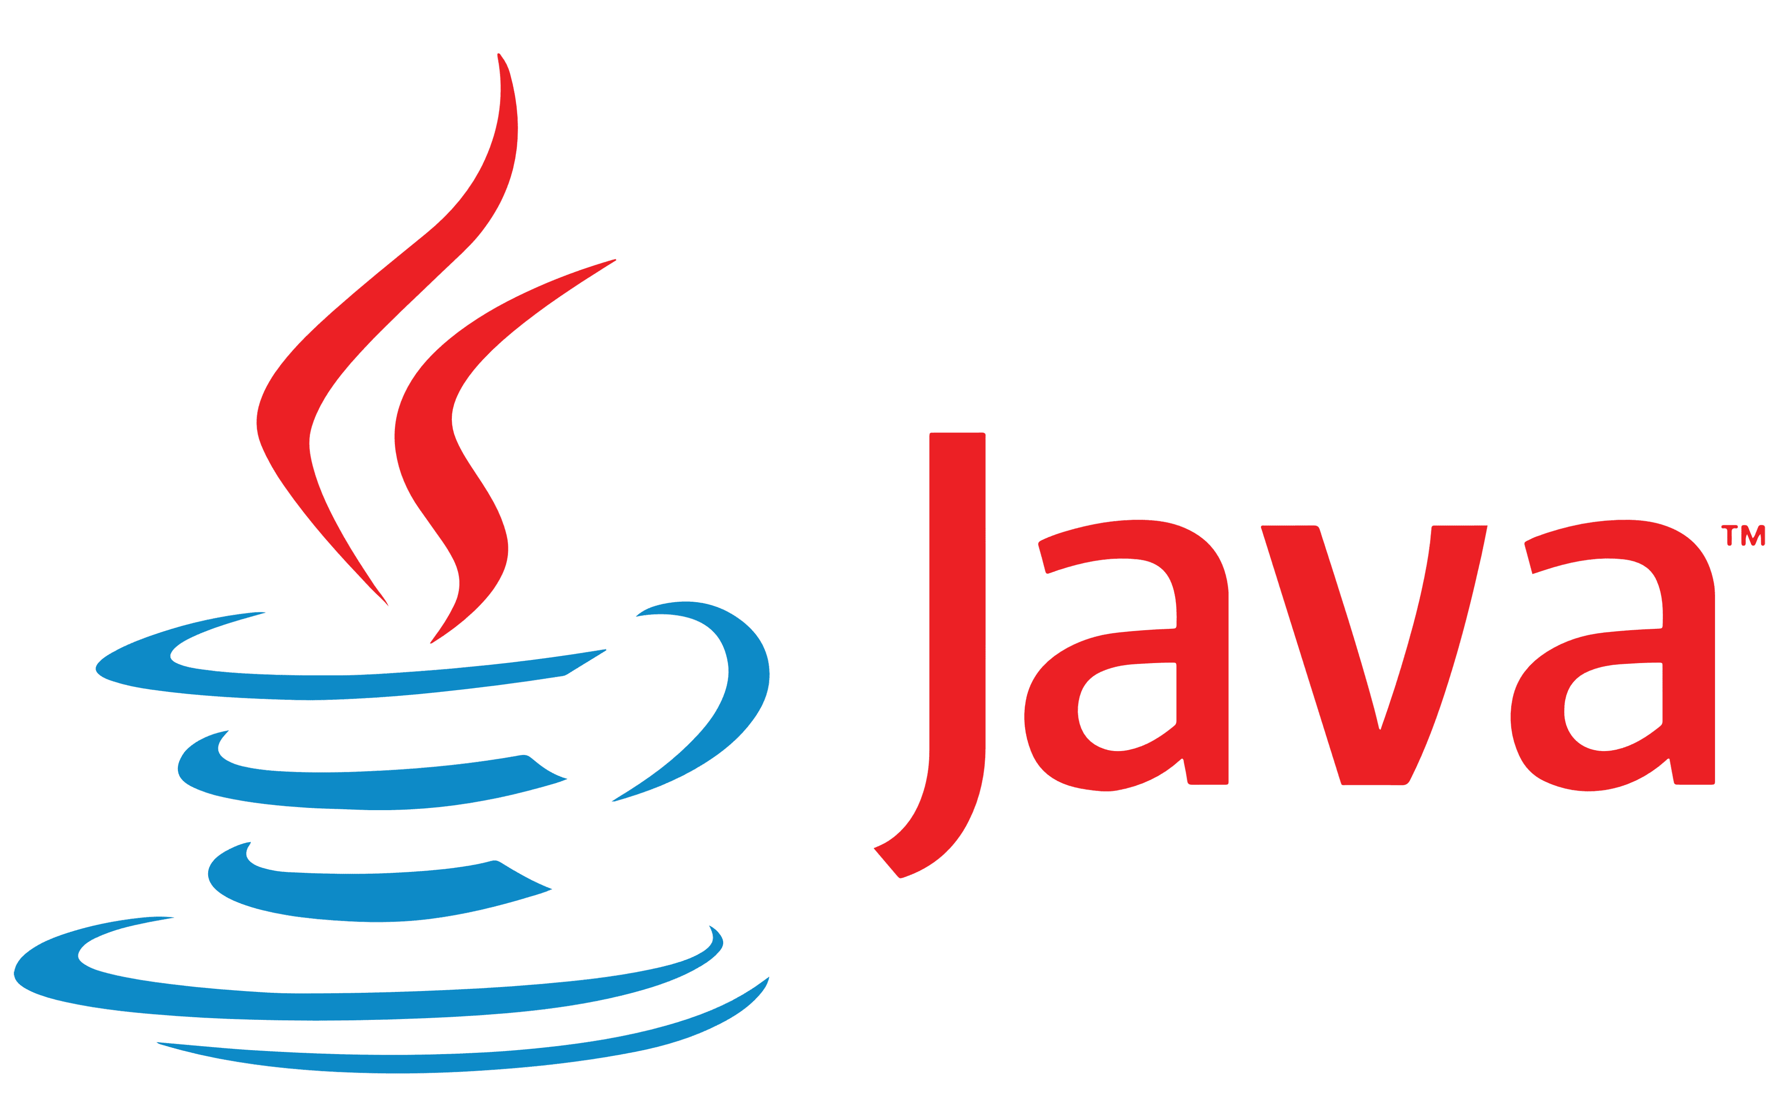
features of Java programming
Total Features: 13

Slide 2
Object Oriented
In Java, everything is an Object. Java can be easily extended since it is based on the Object model.

Slide 3
Platform Independent
Unlike many other programming languages including C and C++, when Java is compiled, it is not compiled into platform specific machine, rather into platform-independent byte code. This byte code is distributed over the web and interpreted by the Virtual Machine (JVM) on whichever platform it is being run on.

Slide 4
Simple
Java is designed to be easy to learn. If you understand the basic concept of OOP Java, it would be easy to master.

Slide 5
Secure
With Java's secure feature it enables to develop virus-free, tamper-free systems. Authentication techniques are based on public-key encryption.

Slide 6
Architecture-neutral
Java compiler generates an architecture-neutral object file format, which makes the compiled code executable on many processors, with the presence of Java runtime system.

Slide 7
Portable
Being architecture-neutral and having no implementation dependent aspects of the specification makes Java portable. The compiler in Java is written in ANSI C with a clean portability boundary, which is a POSIX subset.

Slide 8
Robust
Java makes an effort to eliminate error-prone situations by emphasizing mainly on compile time error checking and runtime checking.

Slide 9
Multithreaded
With Java's multithreaded feature it is possible to write programs that can perform many tasks simultaneously. This design feature allows the developers to construct interactive applications that can run smoothly.

Slide 10
Interpreted
Java byte code is translated on the fly to native machine instructions and is not stored anywhere. The development process is more rapid and analytical since the linking is an incremental and light-weight process.

Slide 11
High Performance
With the use of Just-In-Time compilers, Java enables high performance.

Slide 12
Distributed
Java is designed for the distributed environment of the internet.

Slide 13
Dynamic
Java is considered to be more dynamic than C or C++ since it is designed to adapt to an evolving environment. Java programs can carry an extensive amount of run-time information that can be used to verify and resolve accesses to objects at run-time.

Slide 14
End

